Slide 1
Lecture 7
Understanding Human being as the Co-existence of the Self and the Body

Slide 2


Slide 3
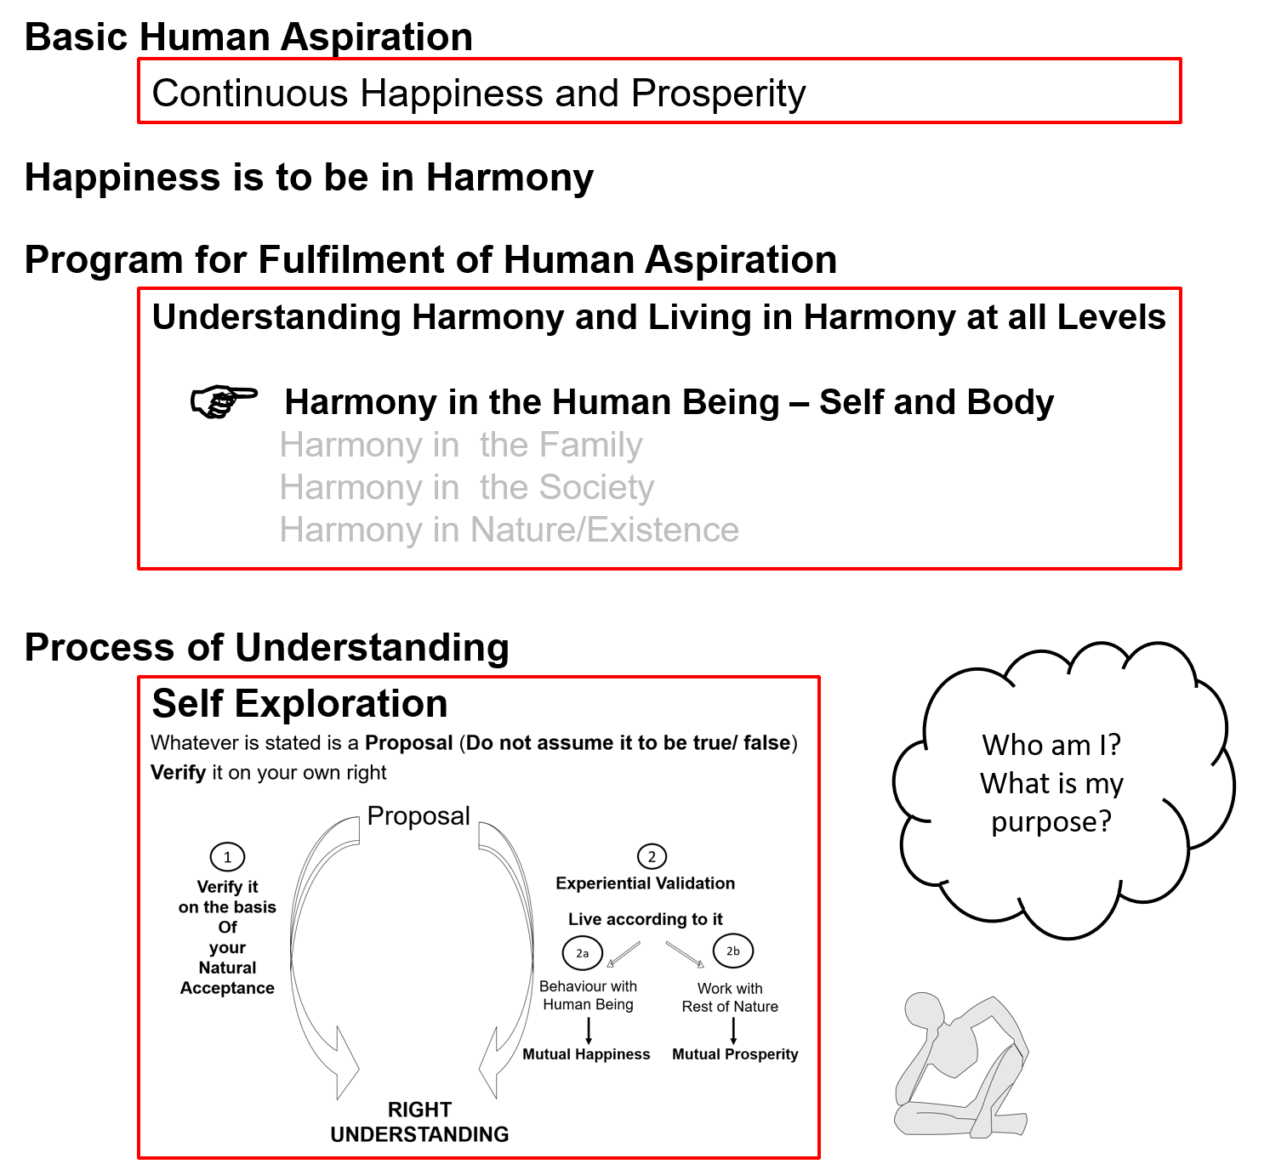

Slide 4
Human Being Ekkuo | Self eSa | Body “kjhj
Co-existence
lgvfLrRo

Slide 5

Human Being Ekkuo | Self eSa | Body “kjhj
Need vko';drk | Happiness (e.g. Respect) lq[k ¼tSls lEeku½ | Physical Facility (e.g. Food) lqfo/kk ¼tSls Hkkstu½
In Time dky esa | Continuous fujUrj | Temporary lkef;d
In Quantity ek=k esa | Qualitative (is Feeling) xq.kkRed ¼Hkko gS½ | Quantitative (Required in Limited Quantity) Ekk=kRed ¼lhfer ek=k esa½
Co-existence
lgvfLrRo
Are these needs are of different types or of same type?
Are both types of needs important / Do we want fulfillment of both types of needs?
Are we working to fulfill both types of needs?
What is the priority between the needs of the Self & the needs of the Body?

Slide 6
Human Being Ekkuo | Self eSa | Body “kjhj
Need vko';drk | Happiness (e.g. Respect) lq[k ¼tSls lEeku½ | Physical Facility (e.g. Food) lqfo/kk ¼tSls Hkkstu½
In Time dky esa | Continuous fujUrj | Temporary lkef;d
In Quantity ek=k esa | Qualitative (is Feeling) xq.kkRed ¼Hkko gS½ | Quantitative (Required in Limited Quantity) Ekk=kRed ¼lhfer ek=k esa½
Fulfilled By iwfrZ ds fy, | Right Understanding & Right Feeling lgh le>] lgh Hkko | Physio-chemical Things HkkSfrd&jklk;fud oLrq
Co-existence
lgvfLrRo
The needs of the Body can not be fulfilled by Right Understanding, Right Feelings alone
The needs of the Self can not be fulfilled by Physio-Chemical Things
Both type of needs have to be understood separately
Both type of needs have to be fulfilled separately
In living, what is the priority?
  How much time & effort is spent for right understanding & right feelings?
  How much time & effort is spent for physical facility?

Slide 7
Human Being Ekkuo | Self eSa | Body “kjhj
Need vko';drk | Happiness (e.g. Respect) lq[k ¼tSls lEeku½ | Physical Facility (e.g. Food) lqfo/kk ¼tSls Hkkstu½
In Time dky esa | Continuous fujUrj | Temporary lkef;d
In Quantity ek=k esa | Qualitative (is Feeling) xq.kkRed ¼Hkko gS½ | Quantitative (Required in Limited Quantity) Ekk=kRed ¼lhfer ek=k esa½
Fulfilled By iwfrZ ds fy, | Right Understanding & Right Feeling lgh le>] lgh Hkko | Physio-chemical Things HkkSfrd&jklk;fud oLrq
Activity fØ;k | Desire, Thought, Expectation… bPNk] fopkj] vk”kk--- | Eating, Walking… [kkuk] pyuk---
In Time dky esa | Continuous fujUrj | Temporary lkef;d
Co-existence
lgvfLrRo

Slide 8
Human Being Ekkuo | Self eSa | Body “kjhj
Need vko';drk | Happiness (e.g. Respect) lq[k ¼tSls lEeku½ | Physical Facility (e.g. Food) lqfo/kk ¼tSls Hkkstu½
In Time dky esa | Continuous fujUrj | Temporary lkef;d
In Quantity ek=k esa | Qualitative (is Feeling) xq.kkRed ¼Hkko gS½ | Quantitative (Required in Limited Quantity) Ekk=kRed ¼lhfer ek=k esa½
Fulfilled By iwfrZ ds fy, | Right Understanding & Right Feeling lgh le>] lgh Hkko | Physio-chemical Things HkkSfrd&jklk;fud oLrq
Activity fØ;k | Desire, Thought, Expectation… bPNk] fopkj] vk”kk--- | Eating, Walking… [kkuk] pyuk---
In Time dky esa | Continuous fujUrj | Temporary lkef;d
Response | Knowing, Assuming*, Recognising, Fulfilling tkuuk] ekuuk] igpkuuk] fuokZg djuk | Recognising, Fulfilling igpkuuk] fuokZg djuk
Co-existence
lgvfLrRo
* Assuming or Accepting

Slide 9
Response
Knowing, Assuming, Recognizing, Fulfilling or Assuming (without knowing), Recognizing, Fulfilling
KNOWING To see the reality as it is, in its completeness, by direct observation
It is definite, continuous and universal
E.g. What is the existential reality Human being = ?, Purpose of human being = ?,
Is the purpose same of different?...
ASSUMING What I accept about that reality, which may or may not be same as the reality as it is
(acceptance can be on the basis of knowing the reality in completeness or
acceptance can also be without knowing the reality in completeness,
i.e. one has not seen the reality or not seen it in its completeness
but assumed something about it)
E.g. I hear that human being = co-existence of Self and Body, but when I have to decide something related to
a human being (me or another), what I have really accepted about human being or that particular human being
comes to the foreground and I decide on the basis of my acceptance (which may or may not match
with the existential reality)
RECOGNISING My relationship with that reality (human being or rest of nature).
I recognise my relationship with any reality and make effort to fulfil that relationship based on my assuming
E.g. If I assume human beings have different purposes, my behaviour with different human beings is different
FULFILLING The relationship with that reality (human being or rest of nature)
E.g. My behaviour with a human being that I recognise as a friend is one way
My behaviour with a human being that I recognise as a foe is onother way

Slide 10
Knowing & Assuming (Accepting)
Knowing, Assuming, Recognizing, Fulfilling
Problem leL;k
Education-Sanskar
Resolution
lek/kku
Preconditioning or
Assuming without Knowing
Assumptions keep changing
Conduct is indefinite (Dependence, Partantrata)
KNOWING To see the reality as it is, in its completeness, by direct observation
It is definite, continuous and universal
ASSUMING What I accept about that reality, which may or may not be same as the reality as it is
(acceptance can be on the basis of knowing the reality in completeness or
acceptance can also be without knowing the reality in completeness,
i.e. one has not seen the reality or not seen it in its completeness
but assumed something about it)
RECOGNISING The relationship with that reality (human being or rest of nature)
FULFILLING The relationship with that reality (human being or rest of nature)
Knowing through self-verification
– on the basis of Natural Acceptance & – on the basis of living accordingly
Assumptions are definite (on the basis of Knowing)
Conduct is definite (Swatantrata)

Slide 11
Human Being Ekkuo | Self eSa | Body “kjhj
Need vko';drk | Happiness (e.g. Respect) lq[k ¼tSls lEeku½ | Physical Facility (e.g. Food) lqfo/kk ¼tSls Hkkstu½
In Time dky esa | Continuous fujUrj | Temporary lkef;d
In Quantity ek=k esa | Qualitative (is Feeling) xq.kkRed ¼Hkko gS½ | Quantitative (Required in Limited Quantity) Ekk=kRed ¼lhfer ek=k esa½
Fulfilled By iwfrZ ds fy, | Right Understanding & Right Feeling lgh le>] lgh Hkko | Physio-chemical Things HkkSfrd&jklk;fud oLrq
Activity fØ;k | Desire, Thought, Expectation… bPNk] fopkj] vk”kk--- | Eating, Walking… [kkuk] pyuk---
In Time dky esa | Continuous fujUrj | Temporary lkef;d
Response | Knowing, Assuming, Recognising, Fulfilling tkuuk] ekuuk] igpkuuk] fuokZg djuk | Recognising, Fulfilling igpkuuk] fuokZg djuk
Co-existence
lgvfLrRo

Slide 12
Human Being Ekkuo | Self eSa | Body “kjhj
Need vko';drk | Happiness (e.g. Respect) lq[k ¼tSls lEeku½ | Physical Facility (e.g. Food) lqfo/kk ¼tSls Hkkstu½
In Time dky esa | Continuous fujUrj | Temporary lkef;d
In Quantity ek=k esa | Qualitative (is Feeling) xq.kkRed ¼Hkko gS½ | Quantitative (Required in Limited Quantity) Ekk=kRed ¼lhfer ek=k esa½
Fulfilled By iwfrZ ds fy, | Right Understanding & Right Feeling lgh le>] lgh Hkko | Physio-chemical Things HkkSfrd&jklk;fud oLrq
Activity fØ;k | Desire, Thought, Expectation… bPNk] fopkj] vk”kk--- | Eating, Walking… [kkuk] pyuk---
In Time dky esa | Continuous fujUrj | Temporary lkef;d
Response | Knowing, Assuming, Recognising, Fulfilling tkuuk] ekuuk] igpkuuk] fuokZg djuk | Recognising, Fulfilling igpkuuk] fuokZg djuk
 | Consciousness pSrU; | Material tM+
Co-existence
lgvfLrRo

Slide 13
Sum Up
Human being is the co-existence of the Self and the Body
The Body is a material unit
The Self is a unit of consciousness
(consciousness is characterized by the activity of assuming and knowing)
The response (recognition & fulfillment) of the body is definite
The response (recognition & fulfillment) of the Self depends on assuming
  If the assuming is based on knowing, the response is definite (the conduct is conduct)
  If the assuming is without knowing, the response is not definite (the conduct is indefinite)

Slide 14
Self Reflection

Slide 15
Key Points
Understanding Human being as the Co-existence of the Self and the Body

Slide 16
Human Being Ekkuo | Self eSa | Body “kjhj
Need vko';drk | Happiness (e.g. Respect) lq[k ¼tSls lEeku½ | Physical Facility (e.g. Food) lqfo/kk ¼tSls Hkkstu½
In Time dky esa | Continuous fujUrj | Temporary lkef;d
In Quantity ek=k esa | Qualitative (is Feeling) xq.kkRed ¼Hkko gS½ | Quantitative (Required in Limited Quantity) Ekk=kRed ¼lhfer ek=k esa½
Fulfilled By iwfrZ ds fy, | Right Understanding & Right Feeling lgh le>] lgh Hkko | Physio-chemical Things HkkSfrd&jklk;fud oLrq
Activity fØ;k | Desire, Thought, Expectation… bPNk] fopkj] vk”kk--- | Eating, Walking… [kkuk] pyuk---
In Time dky esa | Continuous fujUrj | Temporary lkef;d
Response | Knowing, Assuming, Recognising, Fulfilling tkuuk] ekuuk] igpkuuk] fuokZg djuk | Recognising, Fulfilling igpkuuk] fuokZg djuk
 | Consciousness pSrU; | Material tM+
Co-existence
lgvfLrRo

Slide 17
Knowing & Assuming (Accepting)
Knowing, Assuming, Recognizing, Fulfilling
Problem leL;k
Education-Sanskar
Resolution
lek/kku
Preconditioning or
Assuming without Knowing
Assumptions keep changing
Conduct is indefinite (Dependence, Partantrata)
KNOWING To see the reality as it is, in its completeness, by direct observation
It is definite, continuous and universal
ASSUMING What I accept about that reality, which may or may not be same as the reality as it is
(acceptance can be on the basis of knowing the reality in completeness or
acceptance can also be without knowing the reality in completeness,
i.e. one has not seen the reality or not seen it in its completeness
but assumed something about it)
RECOGNISING The relationship with that reality (human being or rest of nature)
FULFILLING The relationship with that reality (human being or rest of nature)
Knowing through self-verification
– on the basis of Natural Acceptance & – on the basis of living accordingly
Assumptions are definite (on the basis of Knowing)
Conduct is definite (Swatantrata)

Slide 18
FAQs for Lecture 7
Understanding Human being as the Co-existence of the Self and the Body

Slide 19
Question(s) 1: Self and Body Response
The Body is tangible but I can’t see the Self. It seems so intangible. How can we see the self? or do we have to assume it only?
Body is tangible- to whom- self or body? How do you see the body? By observing the form of the body, then close your eyes and see if you can still feel that body is there. How do you feel that body is there? By observing the sensation from the body, now who is observing the sensation- self or body? Now, we can see that it is the self who is feeling the sensation and deciding that the body is there, similarly, it is the self who is seeing the form of the body and deciding that the body is there. So, now who is more authentic- self or body, is self authenticating that body is there or otherwise? Certainly, self is more authentic and it is authenticating that body is there.

Slide 20
Question(s) 1: Self and Body Response
There is no talk of Self in Science, Medicine or Biology or Neuroscience etc. Then how can you talk about Self so authentically? What is the need to separate them?
What we are saying is that every one of us can authenticate for himself that self is there; in fact, one can authenticate that he is the self in co-existence with the body and not just the body. If science includes this self, consciousness in its subject of study, it will be able to understand human being better than it is able to do today. So is the case with Medicine or Biology or Neuroscience etc.
When we are alive, we can certainly see that self is there and it is using the body as an instrument, body does what self wants the body to do. Further, we can see that the need and activities of the self are continuous while that of body are temporary; this points towards the possibility of self being continuous while body being temporary. But, i will leave it open for you to reflect for the time being,

Slide 21
Some Implications of Perceiving/ Assuming Human Being = Body
Happiness is sought through
  sensation (through the body)
  getting the right feeling (like respect…) from the other
As a result
  The body is harmed due to excessive consumption or over indulgence to get favourable sensation
  Continuity of happiness can not be ensured
  There is a major impact on family, society, nature…
A large number of diseases are psychosomatic in nature
e.g. Over eating, consumption of "junk food" etc. for happiness - causing obesity and ill health
The lack of feeling (resulting in unhappiness) causes physical symptoms
The environment (family, society, nature…) is not a major concern or it is exploited

Slide 22
Question(s) 1: Self and Body Response
Is there any strict boundary between the two? Is the Self inside the Body?
How are Self and Body connected?
I think that this issue calls for lot of self-exploration before we can discuss about it. Only when we develop the capacity to see the self, the body and the interaction between the two that we will be able to sense of the response.
Transaction between the self and body is in the form of information. Self is giving some instruction to body (to eat for example) and self is reading some sensation (sensation of pain for example) from the body. We will discuss this in detail in later lectures.
Two questions can be asked –
    What is the transaction between the Self and the Body?
    What is the basis for this?

Slide 23
Activities of the Self Body In the Body with involvement of Self
Thinking
Digesting Food
Walking
Breathing

Slide 24
Question(s) 2: Need and Activity Response
I don’t think while sleeping. So, the activities of the Self should be also temporary, isn’t it?
Are some of the needs of the Body also continuous? I always need air and water.
Do you dream while sleeping? Does dream include thinking? Now,, try to be aware of your imagination when you are awake, then slowly you can be aware of your imagination even when you are asleep, then you will be able to verify whether you are thinking while sleeping or not.
Needs and activities of the body are temporary. We breathe in and then breathe out, both breathing in and breathing out are temporary.

Slide 25
Question(s) 2: Need and Activity Response
We do say that I got less respect than the other (on a particular occasion). So isn’t respect also quantitative?
Can you explain more about this desire etc.?
How are the activities of the Body and Self connected?
When we start focussing on the expression of the feeling of respect, it becomes more or less; e.g. One is presented with a flower while the other is not. However if focus on the feeling itself, we can see that either there is feeling of respect or not, nothing in between.
We will do this as we proceed further in this section.
I have already given some hint when i said that Self is giving some instruction to body (to eat for example) and self is reading some sensation (sensation of pain for example) from the body. However, we will elaborate on it as we proceed further.

Slide 27
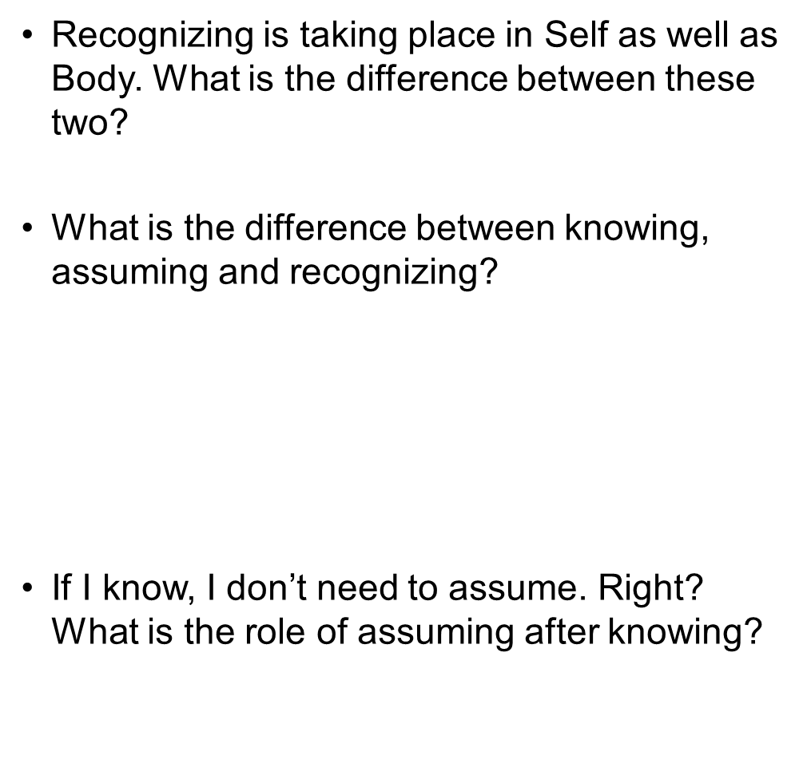
Question(s) 3: Response of Self and Body Response
In case of self, its recognising depends upon assuming as already mentioned.
Knowing is to the reality as it is, in its completeness, assuming is some acceptance about the reality which may or may not be same as the reality as it is. Recognising has to do with recognition of my relationship with that reality.
Assuming is used in the sense of my acceptance; this acceptance may be based on knowing or without knowing.

Slide 28
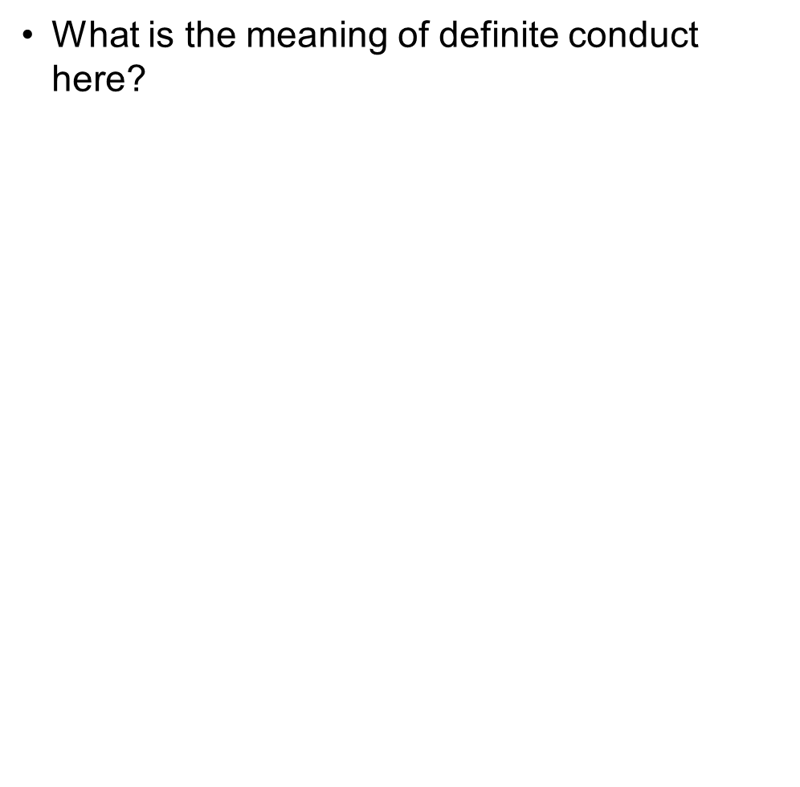
Question(s) 3: Response of Self and Body Response
Definite conduct here means that our feeling in relationship has become definite, e.g. feeling of respect; its expression may still have variety. So, there is space for creativity in expression of the feeling in definite conduct.

